Slide 1
2024 State of the Region Address
Presented by: Dr. Nichole M Fifer, PhD
Director, Center for Regional Development at BGSU

Slide 2
Center for Regional Development
The BGSU Center for Regional Development partners with and convenes community stakeholders to enhance the economic well-being and quality of life in northwest Ohio by serving as :
Data Analytics Provider
Trusted & Neutral Planning Facilitator
Community Engagement Partner
Community Needs Assesment Provider
Program Evaluator
Capacity Builder
Bridge to BGSU Faculty, Students, & Resources
ANALYZE.
STRATEGIZE.
BUILD.
Notes:
The BGSU Center for Regional Development partners with and convenes community stakeholders to enhance the economic well-being and quality of life in northwest Ohio by serving as a Data Analytics Provider, neutral planning facilitator, capacity builder, and Bridge to BGSU Faculty, Students, & Resources.
Data Analytics Provider
Program Evaluator
Trusted & Neutral Planning Facilitator
Community Engagement Partner
Capacity Builder
Bridge to BGSU Faculty, Students, & Resources

Slide 3
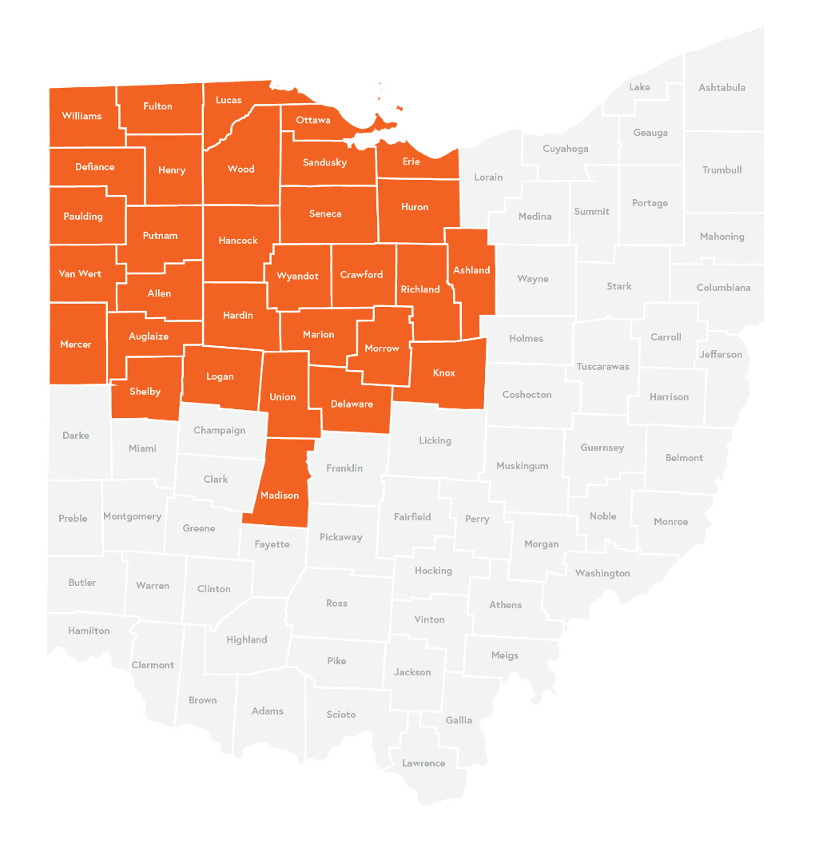

Defining the
Region
As an Economic Development Administration (EDA) University Center and member of the Rural Universities Program of the State of Ohio, CRD serves 31 counties in Northwest Ohio.
Notes:
As an Economic Development Administration (EDA) University Center and member of the Rural Universities Program of the State of Ohio, CRD serves 31 counties in Northwest Ohio.

Slide 4



Overview of the Data in Today’s Presentation
Most of the information in today’s presentation comes from the following publicly available sources:
  Bureau of Labor Statistics (BLS)
  U.S. Census and American Community Survey (ACS)
  Bureau of Economic Analysis (BEA)
  Federal Reserve Banks of St. Louis and Atlanta
  Ohio Labor Market Information (LMI)
Additionally, the presentation contains information that comes from CRD’s subscription to the following data providers:
Notes:
The information in today’s presentation comes from the following publicly available sources:
Bureau of Labor Statistics (BLS)
U.S. Census and American Community Survey (ACS)
Bureau of Economic Analysis (BEA)
Federal Reserve Banks of St. Louis and Atlanta
Ohio Labor Market Information (LMI)
Additionally, the presentation contains information that comes from CRD’s subscription to several data providers including Lightcast, Chmura, and Metopio.

Slide 5

Regional Economic Indicators

Slide 6
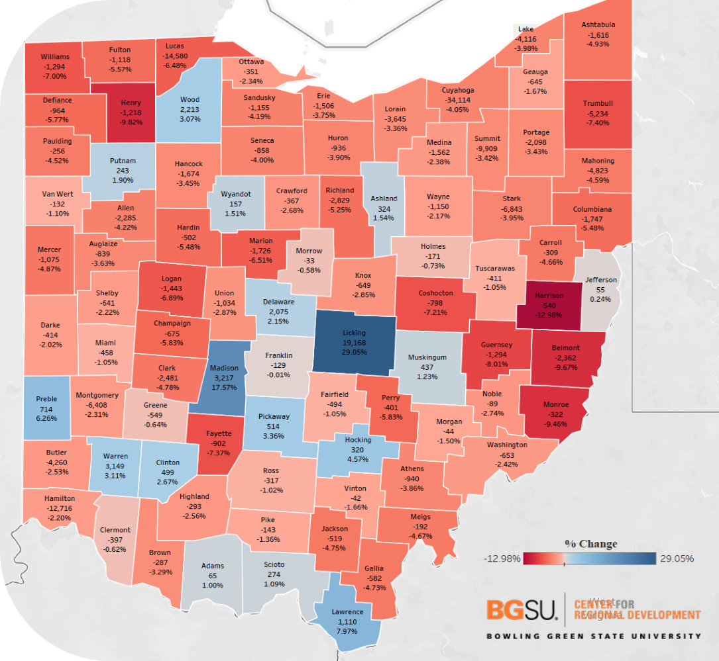
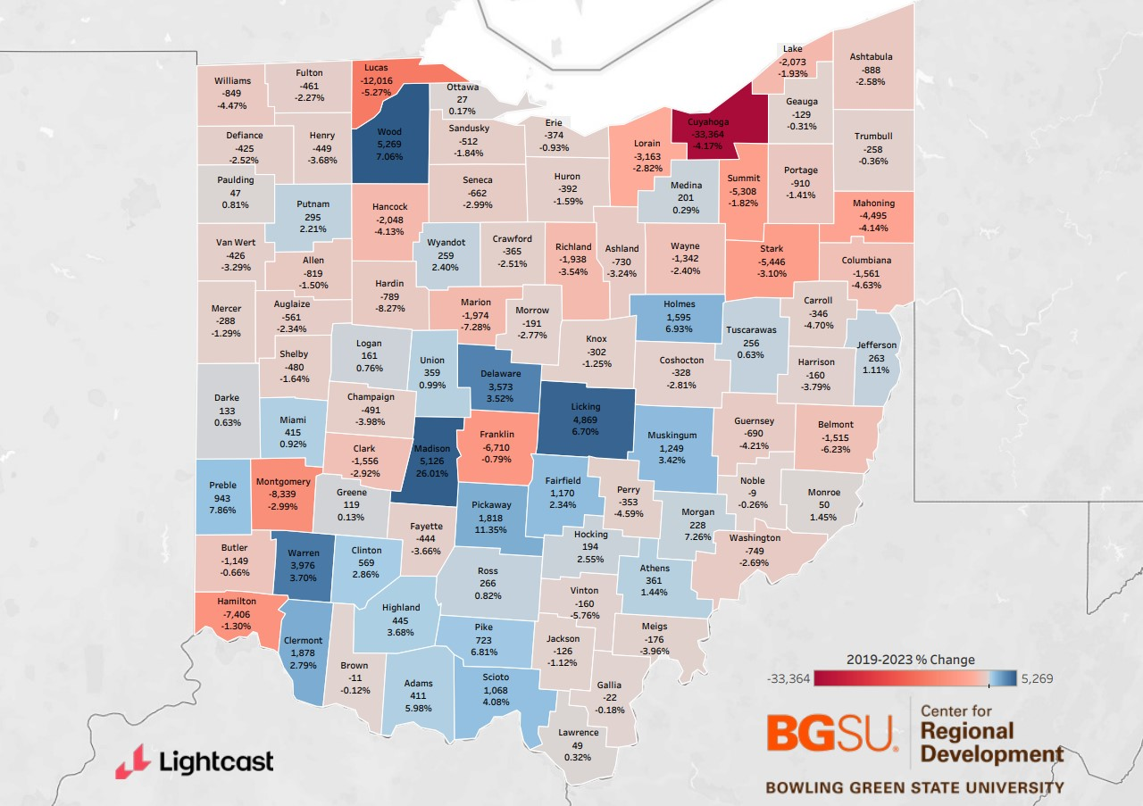
State of Ohio Job Growth by County
Total by County (2018-2022)
Total by County (2019-2023)
Notes:
This map highlights job growth across counties in Ohio from consecutive 5 year periods. 2018-2022 and 2019 to 2023.
Though most counties in Ohio continue to see job losses rather than gains, the trajectory has improved with many more adding jobs and the size of net losses significantly decreased.
In 2019-2023, 34 of 88 Counties saw job gains ( in comparison to only 16 counties in the previous assessment 18-22).
Most of the counties seeing losses (31/54), saw losses less than 3%. No county saw losses over 8%.
As the color gradient in the map shows, much of the job growth in the state remains concentrated in suburban counties of Columbus and Cincinnati, however the radius of growth has expanded.

Slide 7
State of Ohio Job Growth by County
Total by County (2019-2023)
TOP COUNTIES WITH JOB GAINS
Wood (5,269; 7.06%)
Madison (5,126; 26.01%)
Licking (4,869; 6.69%)
Warren (3,976; 3.7%)
Delaware (3,573; 3.52%)
Notes:
Wood, Madison, Licking are the top counties for net job gains – seeing 5,000+ jobs each.
Warren and Delaware follow with 4k and 3600 each.
Except for Madison and Pickaway counties, which saw gains of 26% and 11.3% respectively, counties gaining jobs have seen gains between 2-5% over the past 5 years.
Most of the counties seeing losses (31/54), saw losses less than 3%. No county saw losses over 8%.

Slide 8
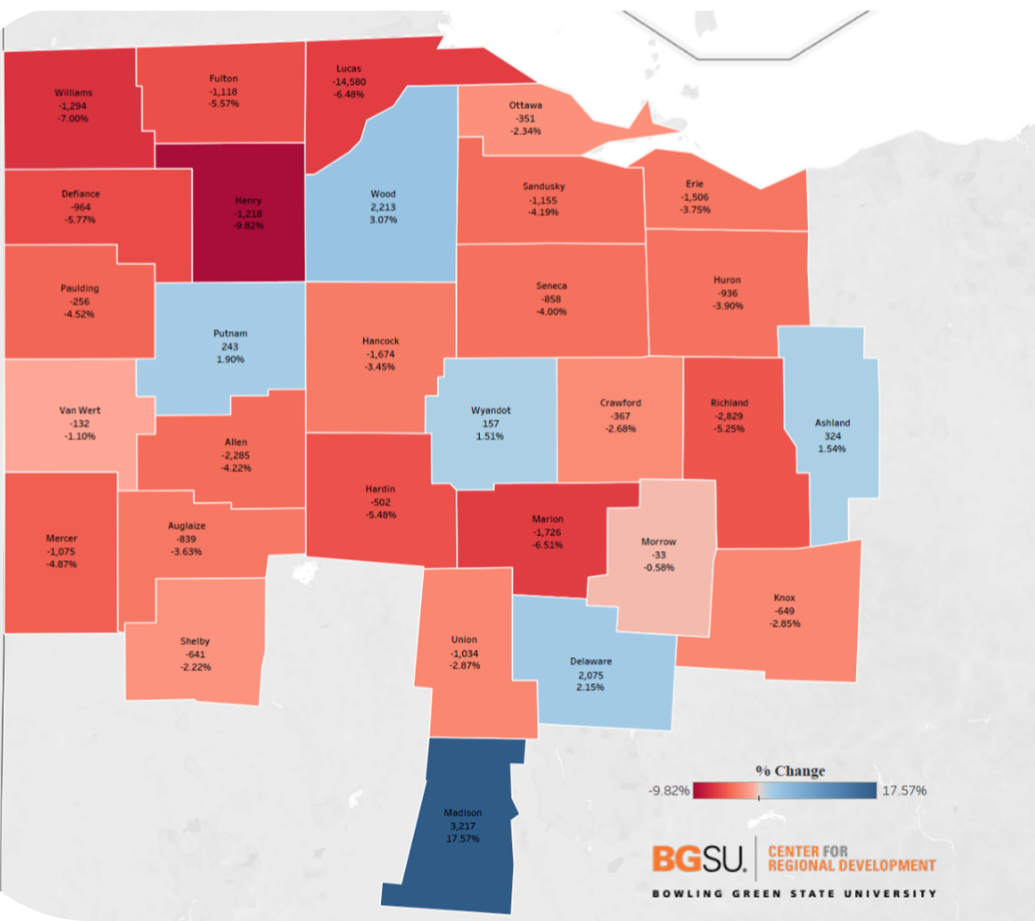
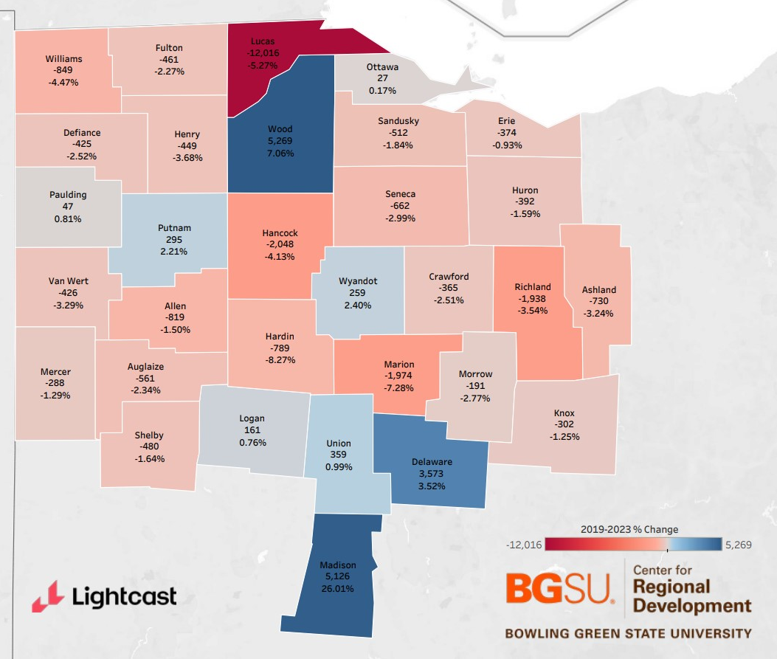
Northwest Ohio Job Growth
Total by County (2018-2022)
Total by County (2019-2023)
Notes:
When we focus in on Northwest Ohio, we see that 9 counties across the 31-county region saw job growth (over 6 last cycle)

Slide 9
Northwest Ohio
Job Growth
Total by County (2019-2023)
TOP COUNTIES WITH JOB GAINS
Wood (5,269; 7.06%)
Madison (5,126; 26.01%)
Delaware (3,573; 3.52%)
Union (359; .99%)
Putnam (295; 2.21%)
Wyandot (259; 2.4%)
Logan (161; .76%)
Notes:
Over the five-year period including Wood, Madison, Wood, Delaware, Union, Putnam, Wyandot, Logan, Paulding and Ottawa.
Expect Madison (26%) and Wood (7%), job gains have been less than 4%.

Slide 10
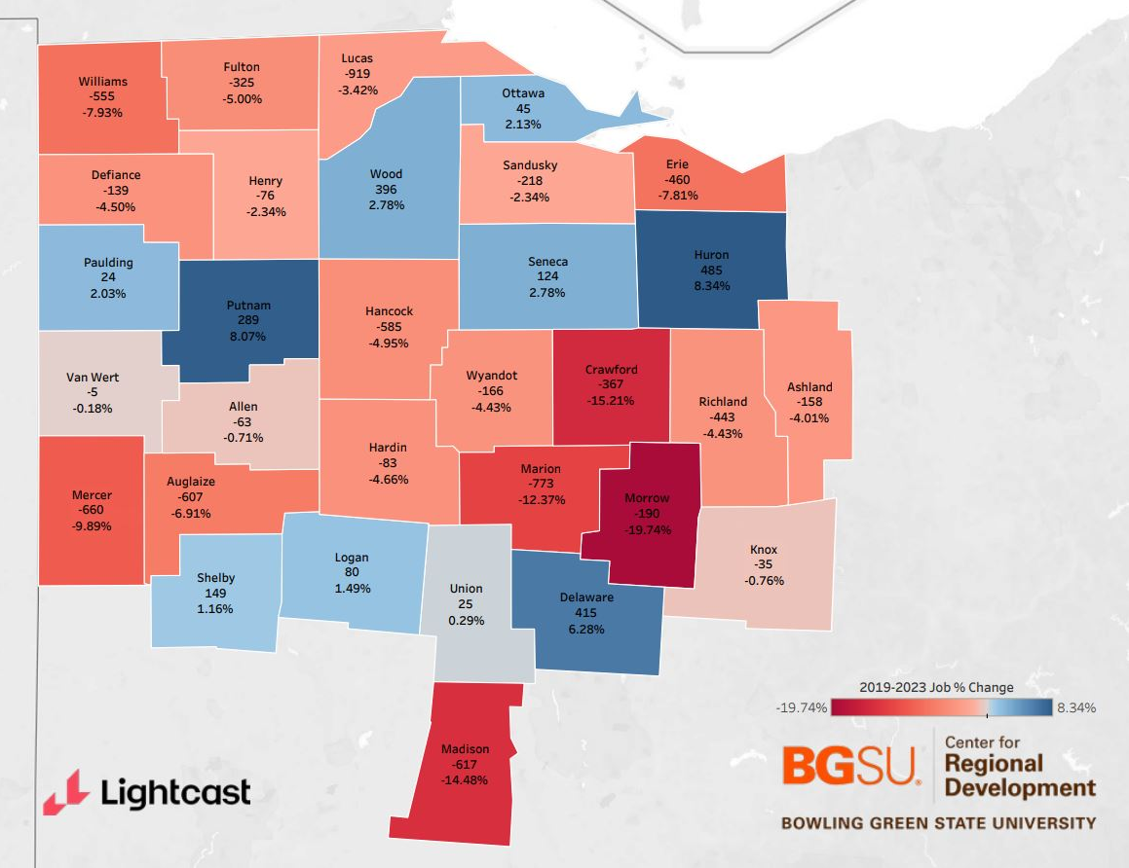
Northwest Ohio Job Growth by County
Manufacturing (2019-2023)
TOP COUNTIES WITH JOB GAINS
Huron (485; 8.34%)
Putnam (289; 8.07%)
Delaware (415; 6.28%)
Wood (396; 2.78%)
Seneca (124; 2.78%)
Notes:
The next series of slides look at job change in key industry sectors from 2019 to 2023.
When we look at manufacturing, we see the greatest job gains in Huron County with 485 jobs added in manufacturing since 2019, an 8.3% increase.
Putnam county also sees an 8% increase in Manufacturing jobs with 289 jobs added.
Delaware has added 415 jobs equating to a 6.3% increase.
Wood and Seneca both saw 3% increases, adding 396 and 124 jobs respectively.

Slide 11
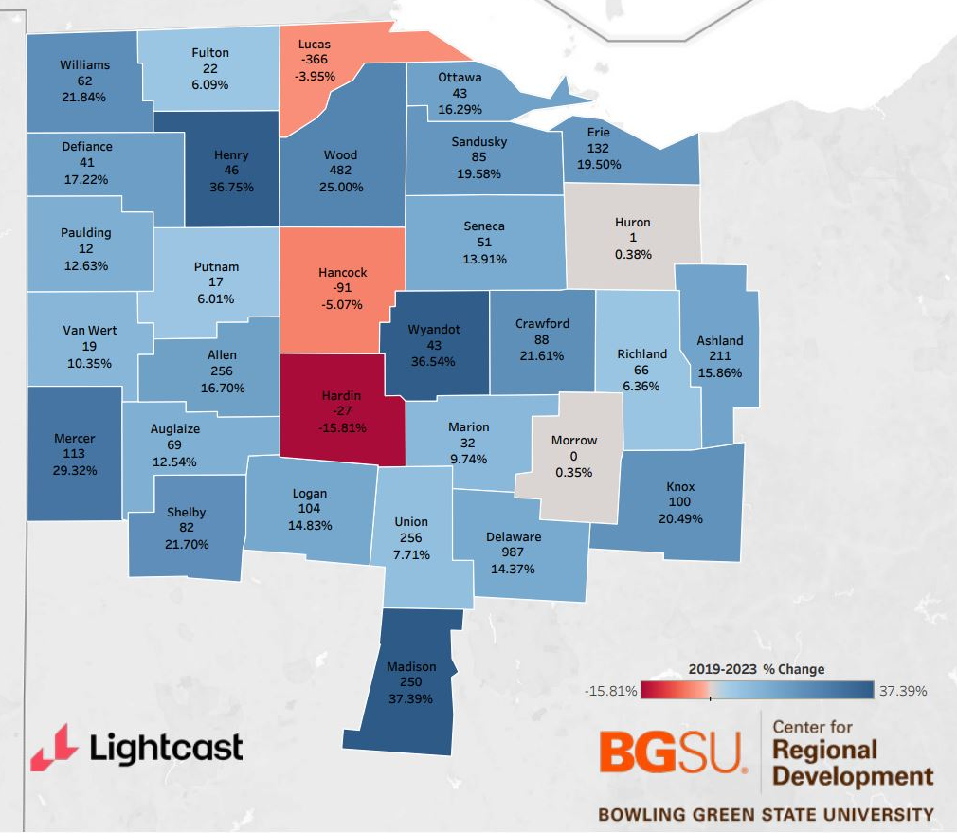
Northwest Ohio Job Growth by County
Professional, Scientific, & Technical
Services (2019-2023)
TOP COUNTIES WITH JOB GAINS
Madison (250; 37.39%)
Henry (46; 36.75%)
Wyandot (43; 36.54%)
Mercer (113; 29.32%)
Wood (482; 25.00%)
Notes:
When we look at Professional, Scientific, and Technical services jobs, we see job growth across most of the region, albeit in small numbers for most counties.
In this sector we see the greatest increase in the number of positions concentrated in a few counties including Delaware County with 987, and Wood with 482
Union, Allen, and Madison say increases near 250 and Ashland saw 200 new jobs in professional scientific and technical services.
We see the highest percent increase in Madison, Henry, and Wyandot counties each seeing an over 36% increase. Mercer saw a 29% increase and Wood saw 25%
Losses in Hardin, Hancock, and Lucas.

Slide 12
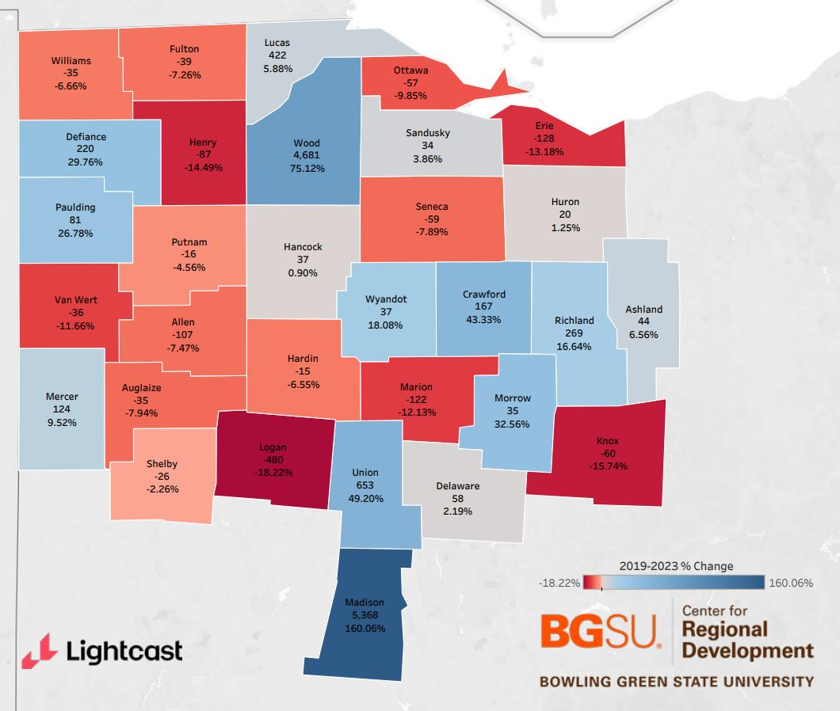
Northwest Ohio Job Growth by County
Transportation and Warehousing
(2019-2023)
TOP COUNTIES WITH JOB GAINS
Madison (5,368; 160%)
Wood (4,681; 75.12%)
Union (653; 49.20%)
Lucas (422; 5.88%)
Richland (269; 16.64%)
Notes:
When we look at transportation and warehousing, we see more counties with job losses than gains.
Madison County, outside of Columbus, and Wood County both show significant job gains.
Madison county saw nearly 5,400 new jobs in the field (an 160% increase) and Wood added nearly 4,700 jobs (a 75% increase).
Union County also saw significant job growth in this area adding 653 jobs in transportation and warehousing, a 49% increase in the past 5 years.
Lucas County saw 422 new jobs, Richland saw 269, and Defiance County saw 220.
The greatest percentage increases were seen in Madison, Wood, Union, Crawford, and Morrow Counties.
Greatest losses were seen in Logan, Knox, Henry and Erie (18-13%)

Slide 13
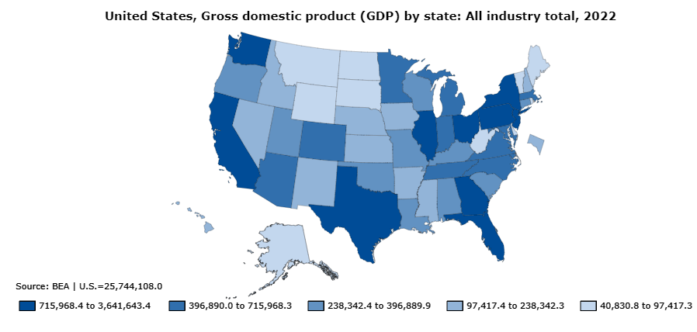

State of Ohio GDP Growth (2022)
Notes:
In 2022, the real gross domestic product (GDP) of Ohio was 638.91 billion U.S. dollars. This is a significant increase from the previous year, when the state’s real GDP stood at 629.29 billion U.S. dollars.
Ohio ranks 6th in the nation following California, Texas, New York, Florida, Illinois, and Pennsylvania

Slide 14
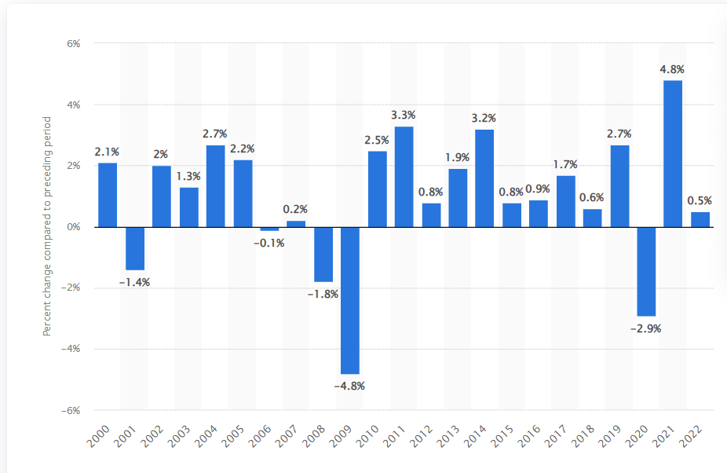
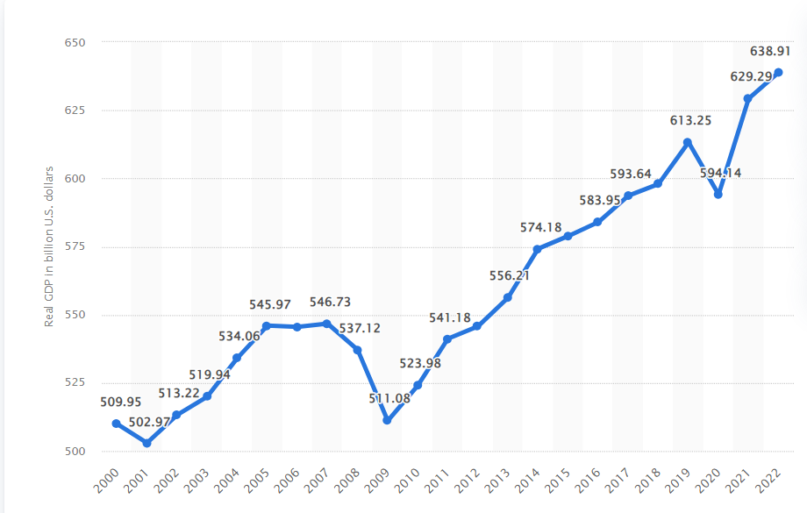
State of Ohio GDP Growth (2000-2022)
Notes:
In 2022, the real gross domestic product (GDP) of Ohio increased by 1.5 percent compared to the previous year. 2021 saw most growth in the state's GDP (5.9%) in ten years as the economy rebounded from the pandemic. The shrinkage in the GDP of Ohio in 2020 can be attributed to the COVID-19 pandemic.

Slide 15
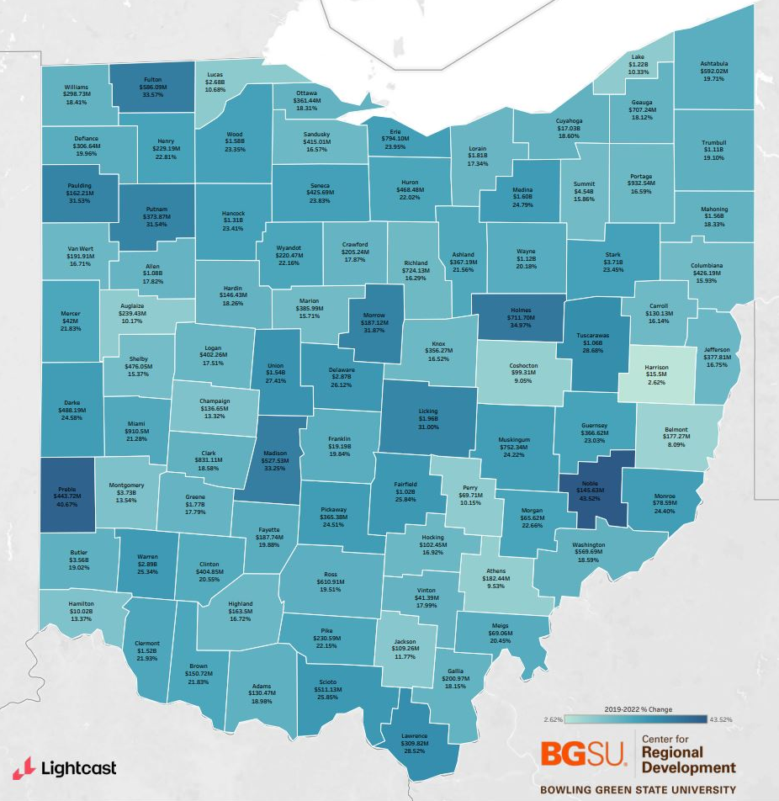
State of Ohio GRP Growth
Total by County (2019-2023)
TOP COUNTIES WITH GRP GAINS
Franklin ($19.19B; 19.84%)
Cuyahoga ($17.03B, 18.12%)
Hamilton ($10.2B, 13.37%)
Summit ($4.54B, 15.86%)
Montgomery ($3.73B, 13.54%)
Notes:
While most counties in Ohio have experienced net job loss over the past five years, we have seen significant increases in the Gross Regional Product within each county.
As we might expect, the counties with the largest total gains in GDP are Franklin, Cuyahoga, and Hamilton (seeing 19.2, 17, and 10.2 Billion Dollar gains respectively). Summit, Montgomery, Butler, Warren and Stark all saw increases between 3 and 4 billion each. The average increase in GDP for counties in Ohio was about 20%.
Greatest growth by percentage was see in
Noble (43.5%)
Preble (40.7%)
Holmes (35%)
Madison (33.25%)
Fulton (33.6%)

Slide 16
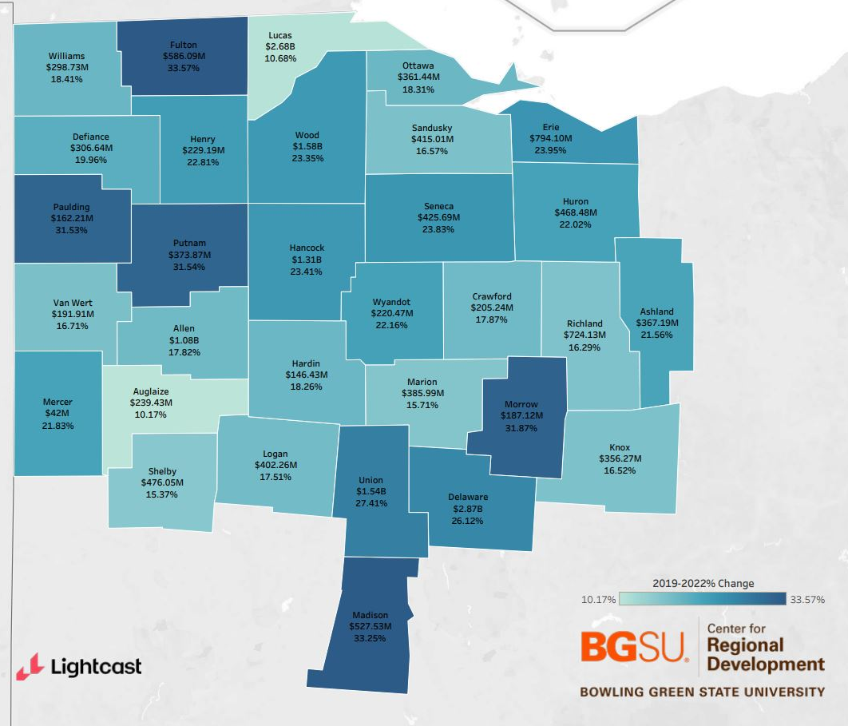
Northwest Ohio
GRP Growth
Total by County (2019-2023)
TOP COUNTIES WITH GRP GAINS
Delaware ($2.86B; 26.12%)
Lucas ($2.69B; 10.68%)
Wood ($1.59B; 23.35%)
Union ($1.54B; 27.41%)
Hancock ($1.31B; 23.41%)
Notes:
When we look at GRP across Northwest Ohio, we see the largest gains have been Delaware, and Lucas Counties with over $2.9 and 2.7 billion dollars gains respectively, since 2019.
Wood, Union, and Hancock follow with gains between 1.3 and 1.6 billion each.
The greatest percentage increases in GRP in the five-year period were seen in Fulton, Madison, Morrow, Putnam, and Paulding with increases over 30%. between 31-33%.
17 of 31 counties saw GRP growth over 20%

Slide 17
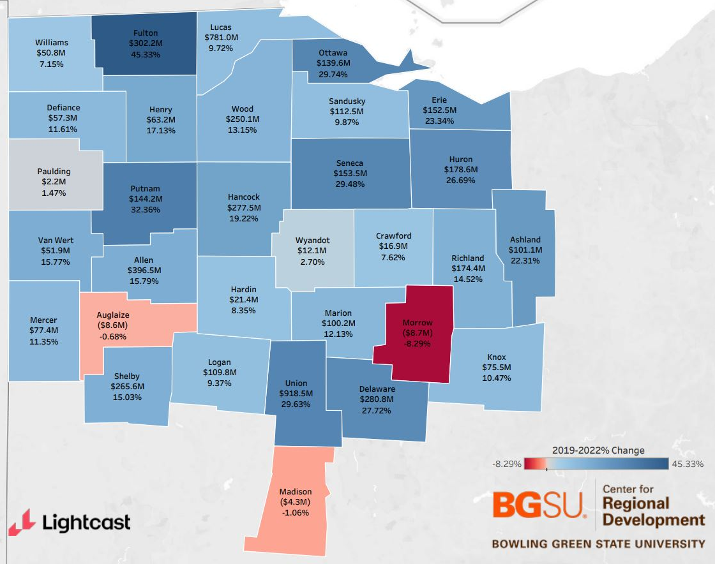
GRP Growth by County
Manufacturing (2019-2023)
TOP COUNTIES WITH GRP GAINS
Franklin($19.2B; 19.8%)
Cuyahoga($17B; 18.6%)
Hamilton ($10B; 13.4%)
Summit ($4.5B; 15.9%)
Montgomery ($3.7B; 13.5%)
Notes:
The next three slides break down GRP change from 2018-2022 by county by key industry sectors.
Here we see the top counties with GRP gains in manufacturing.
Union County gained over $1.5 billion in GRP, or 73% , and Allen saw an increase of $685 Million from manufacturing over the past five years.
Hancock, Lucas, Delaware and Fulton Counties all saw gains of 300-400 million and Wood county came in just under $230 Million.
Except for Crawford and Madison, every county in the region saw GRP gains from manufacturing in the 5-year period.

Slide 18
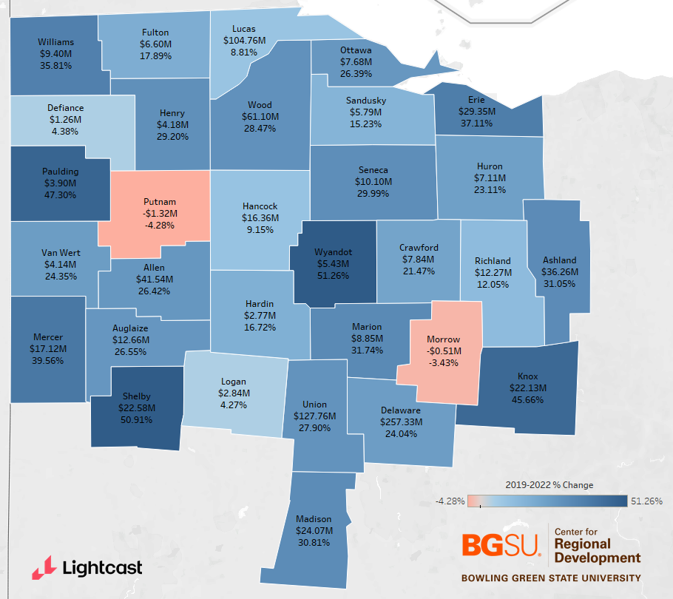
GRP Growth by County
Professional, Scientific, & Technical
Services (2019-2023)
TOP COUNTIES WITH GRP GAINS
Delaware ($257.3M; 24%)
Union ($127.8M; 28%)
Lucas ($104.7M; 9%)
Wood ($61.1M; 28%)
Allen ($41.5M; 26%)
Notes:
When we look at GRP growth from 2019 to 2023 in professional, scientific, and technical services, we see widespread gains and an average county level increase of about 25%.
Delaware County had the largest GRP increase of $257 million, which is a 24% gain.
The next closest in terms of total gains is Union county at $128 million, followed by Lucas at $105 million.
Wood and Allen come in with gains of 60 and 40 million respectively.
The greatest percent changes were in Wyandot, Shelby, Paulding, Knox, and Mercer – all with percentage increases between 40-50%.
Slight losses are seen in Putnam and Morrow Counties (losing 4 and 3 % respectively)

Slide 19
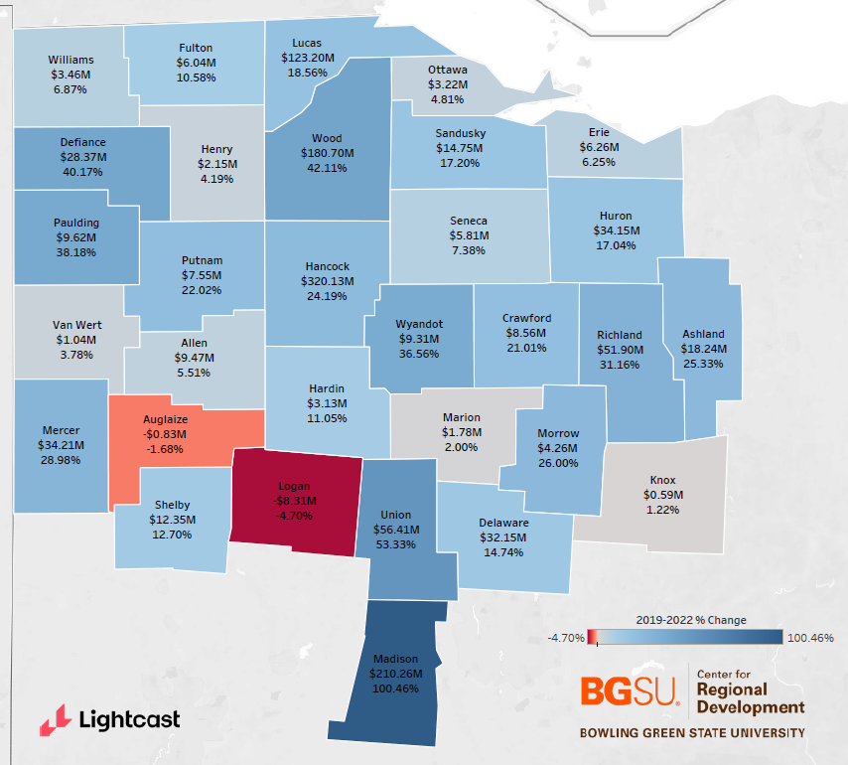
GRP Growth by County
Transportation and Warehousing
(2019-2023)
TOP COUNTIES WITH GRP GAINS
Hancock ($320.1M; 24%)
Madison ($210.3M; 100%)
Wood ($180.7M; 42%)
Lucas ($123.2M; 19%)
Union ($56.4M; 53%)
Notes:
Finally, we see widespread gains when it comes to transportation and warehousing across northwest Ohio. We see relatively large gains in Hancock, Madison and Wood, with gains of 320, 210, and 180 million respectively.
Lucas saw a jump in gains bringing the 5 year average up to 123M (previously 72)
Union, Richland, Mercer, Huron, and Delaware counties all saw modest GRP increases between 30 and 50 million
13/31 Counties saw GRP increases over 20%
Logan and Auglaize saw GRP losses in Transportation and Warehousing.

Slide 20

Regional Workforce Update

Slide 21
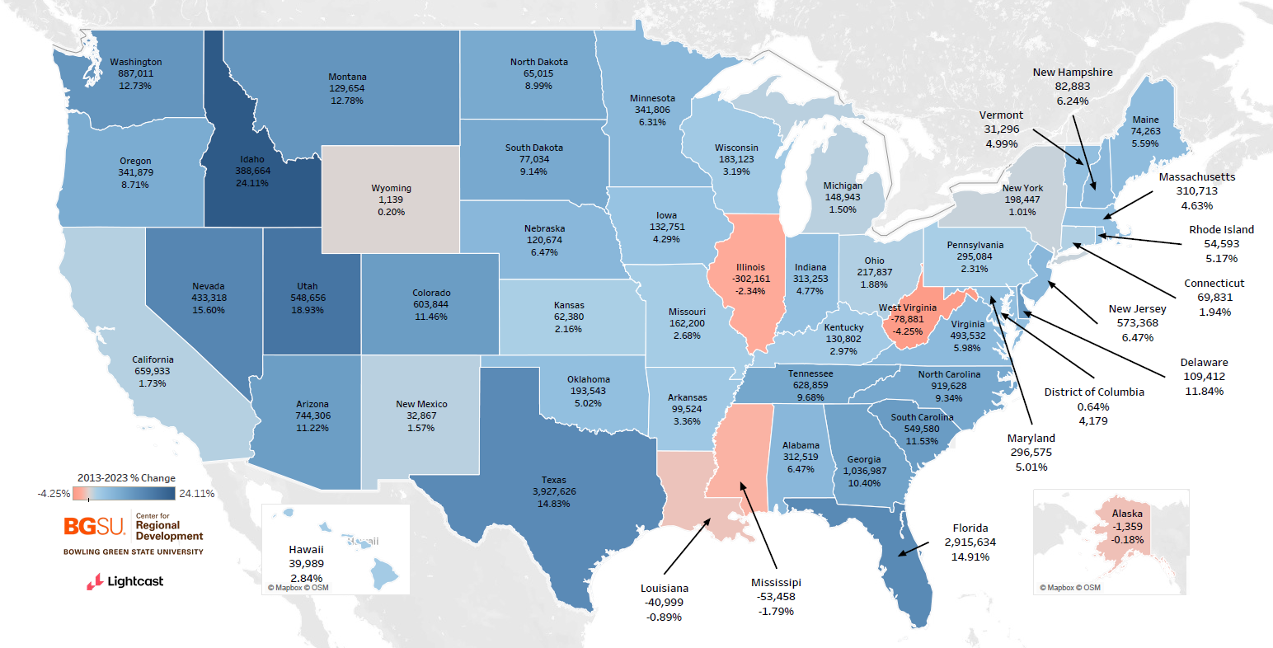
Estimated Population Change by State (2013-2023)
Notes:
Over the past 10 years, most of the growth in the U.S. population has taken place in the mountain west, Texas, and the southeastern United States while the Midwest has seen relatively low population growth.
Ohio saw an increase of approximately 217,837 people over the past 10 years, or 1.88% population increase.
This is similar to the growth experienced by our neighbors- growth in Michigan was 1.5%, Pennsylvania 2.31%, Kentucky 2.97%, while Indiana did a little better with 4.77 % growth.
West Virginia and Illinois saw the greatest decreases in the nation with population losses of 4.25% and 2.34%.
Idaho and Utah saw the greatest population gains at 24% and 19% respectively.

Slide 22
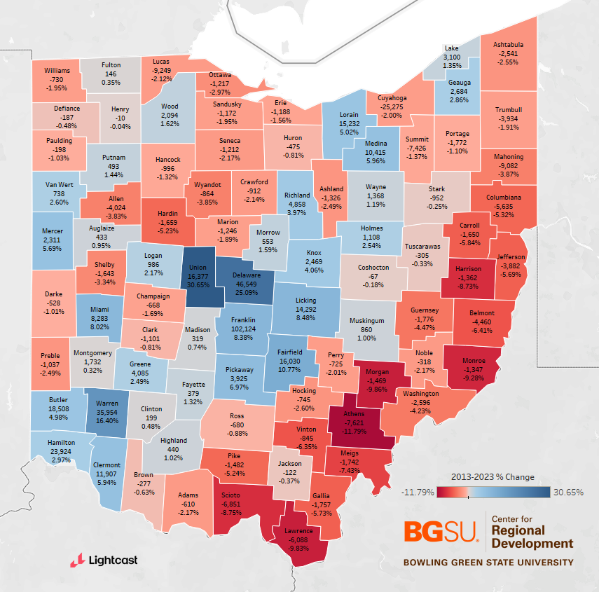
Ohio Population Change by County
(2013-2023)
TOP COUNTIES WITH POPULATION
GAINS
Union (16,377; 31%)
Delaware (46,549; 25%)
Warren (35,954; 16%)
Fairfield (16,030; 11%)
Licking (14,292; 8%)
Notes:
Ohio’s modest population growth is not evenly distributed throughout the state.
Most of the state’s population growth over the past 10 years is in Central Ohio, southwest Ohio, and suburban counties around the State’s major metro areas while the Appalachian region and the Mahoning Valley saw significant population loss over the same time period.
As a percentage, Union county was the fastest growing county in the State at 31% followed by Delaware at 25%, Warren at 26%, Fairfield at 11%, and Licking at 8%.

Slide 23
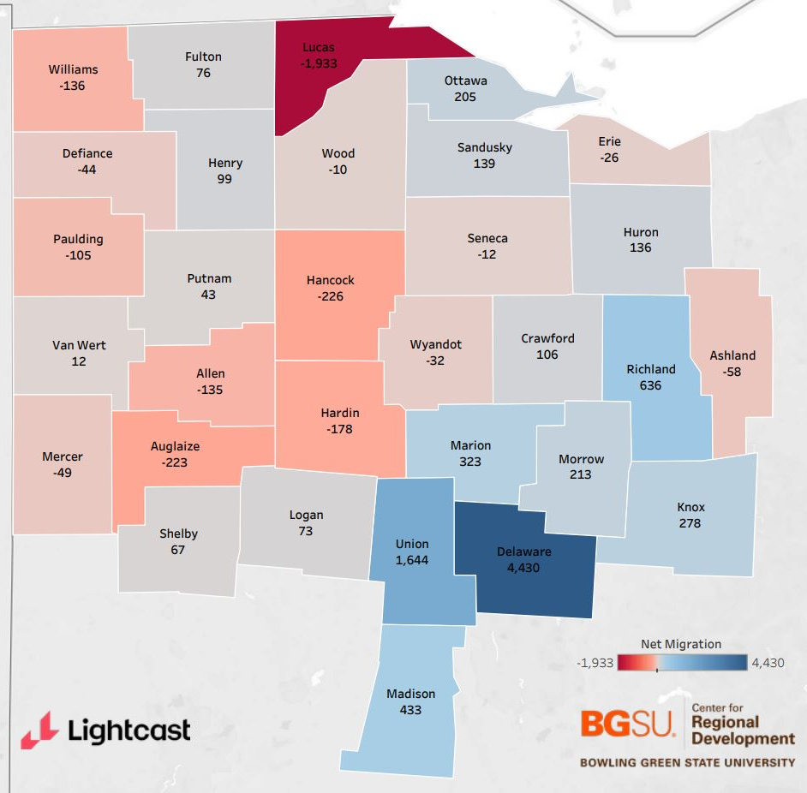
Net Migration by County
2021
TOP COUNTIES WITH NET INWARD
MIGRATION
Delaware (4,430)
Union (1,644)
Richland (636)
Madison (433)
Marion (323)
Notes:
A significant component of population change is how many people are migrating to the region.
This figure highlights the net number of people who migrated to each county in 2021.
As we saw in the 2019 and 2020 data Delaware, Union, and Richland counties had the highest level of inward net migration across the region in 2021, with Delaware seeing a net gain of 4,430, Union 1,644, and Richland 636.
Additionally, Ottawa, Marrow, and Knox Counties all saw increases of 200+.
Lucas county saw the highest level of outward net migration again in 2021 losing 1,315 residents (up from 1,933 in 2020).
Auglaize and Hancock saw outward net migration of 200+ in 2021.
Net migration to the region was 5,746 up from 4,376 the previous year.

Slide 24
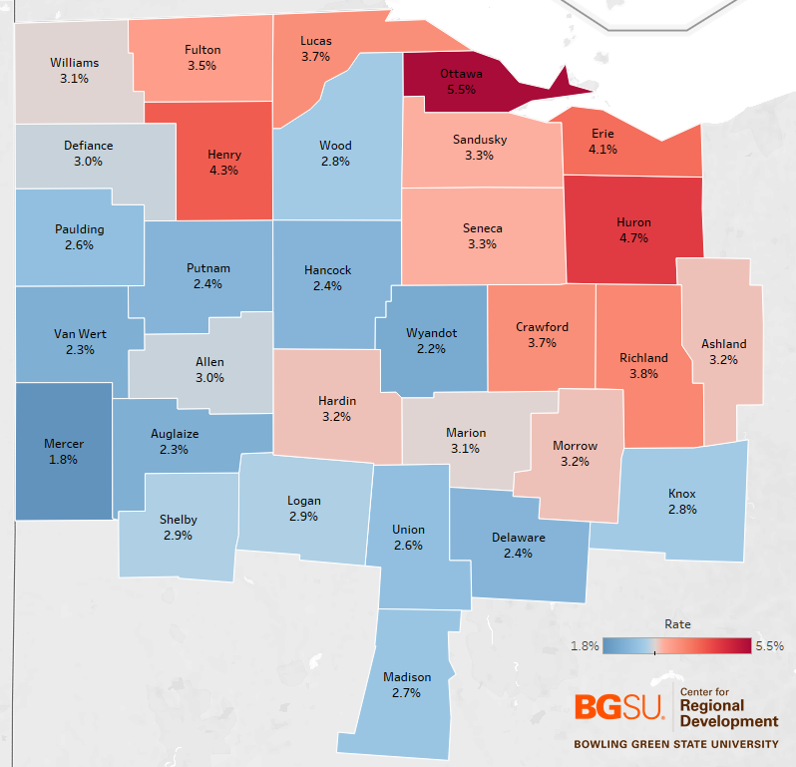
Unemployment
December 2023- Not Seasonally Adjusted
LOWEST UNEMPLOYMENT RATES
Mercer (1.8%)
Holmes (2.10%)
Wyandot (2.42
Auglaize (2.3%)
Van Wert (2.3%)
Delaware (2.6%)
Notes:
This figure shows the unemployment rate in December 2023 for all counties in Northwest Ohio. The unadjusted statewide unemployment rate was 3.1% in December 2023, significantly down from the December 2022’s unadjusted rate of 3.6%, Ohio was one of six states that saw record low unemployment rates in 2023. Others included Maryland, Mississippi, N Dakota, Pennsylvania, and Vermont.
The US unemployment rate in December 2023 was 3.5% slightly up from December 2022 (3.3 percent) down from 3.9% in December 2021.
The map shows counties below the statewide unemployment rate highlighted in blue and those at or above highlighted in red. County unemployment rates for the state range from 1.8 % to 5.8% (Monroe County).
All but one of the 5 counties with the lowest unemployment rates in the state are located in our region including Mercer, Wyandot, Auglaize, and Van Wert--all with unemployment rates below 2.3%.
Delaware, Hancock, and Putnam all have unemployment rates under 2.5%

Slide 25
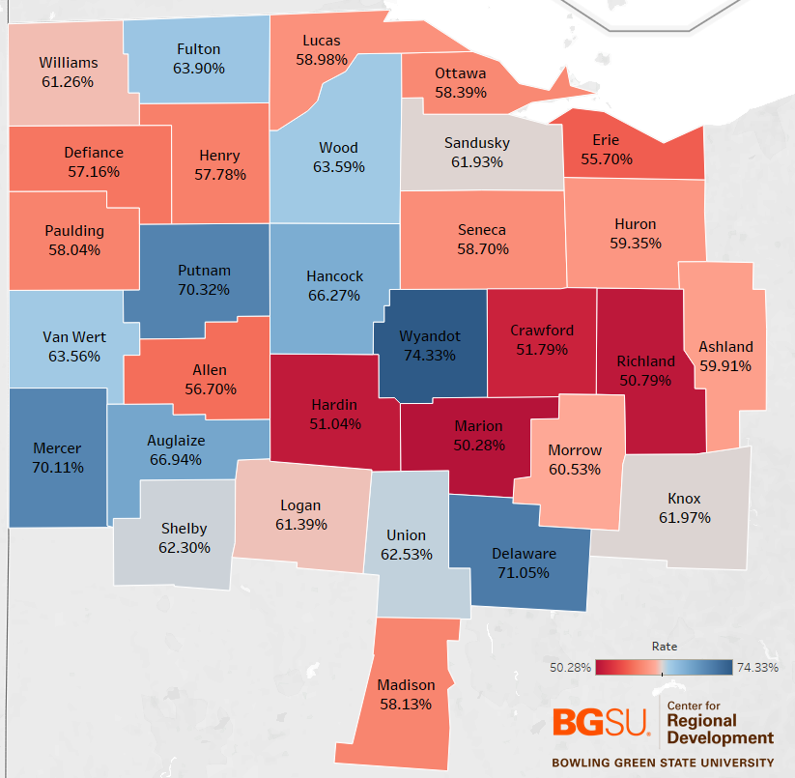
Labor Force Participation Rate
December 2023
COUNTIES WITH HIGHEST LABOR
FORCE PARTICIPATION RATES
Wyandot (74.33%)
Delaware (71.05%)
Putnam (70.32%)
Mercer (70.11%)
Auglaize (66.94%)
Notes:
This figure highlights the December 2023 labor force participation rate for counties in Northwest Ohio with the red counties indicating a labor force participation rate below Ohio’s statewide rate of 61.9% and blue counties indicating a rate above the state average.
In December 2023, the labor force participation rate in Ohio was 61.9%, up from 61.5 % in 2022.
During the same period, the national labor force participation rate was 62.6%, up from 62.3% in 2022..
With the exception of Auglaize County, the top five are the same as 2022- with Auglaize displacing Hancock as #5. Pushing Hancock to 6th.
Wyandot County has the highest labor force participation rate in the region at 74.33- up from 72.92 in 2022%.
As in 2022- Delaware, Putnam, and Mercer Counties all also have labor force participation rates above 70%.
Auglaize and Hancock have labor force participation rates above 66%.
Fulton, Wood, and Van Wert have rates above 63%.
The counties with the lowest labor force participation rates in the region are Marion, Richland, Hardin, and Crawford counties. All around 50-51%.

Slide 26
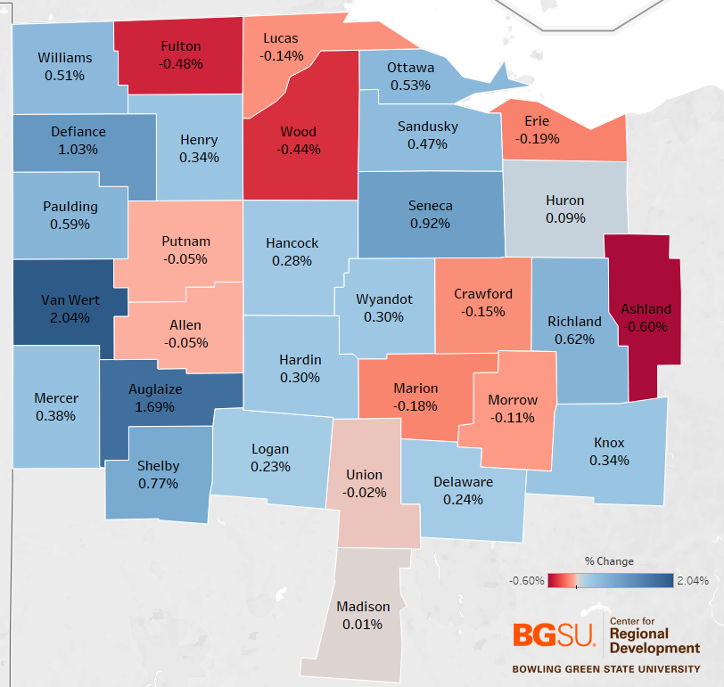
Labor Force Participation Rate
(Dec. 2022-Dec. 2023)
COUNTIES WITH GREATEST LABOR
FORCE PARTICIPATION INCREASES
Van Wert (2.04%)
Auglaize (1.69%)
Defiance (1.03%)
Seneca (0.92%)
Shelby (0.77%)
Notes:
This slide examines the year over year change in the labor force participation rate between December 2022 and December 2023.
In 2021 only six counties in our 31-county region saw an increase in the labor force participation rate, last year we saw increases in 11 counties and 2023 brought increase in 20 Counties.
with Van Wert County having the highest rate increase at 2.04%.
We see more modest increases in participation and smaller decreases in participation overall.
Only Ashland County sees a decease greater than half a percent- No counties in the region have seen a decrease over .6% in their labor force year over year.

Slide 27

Regional Connectivity

Slide 28
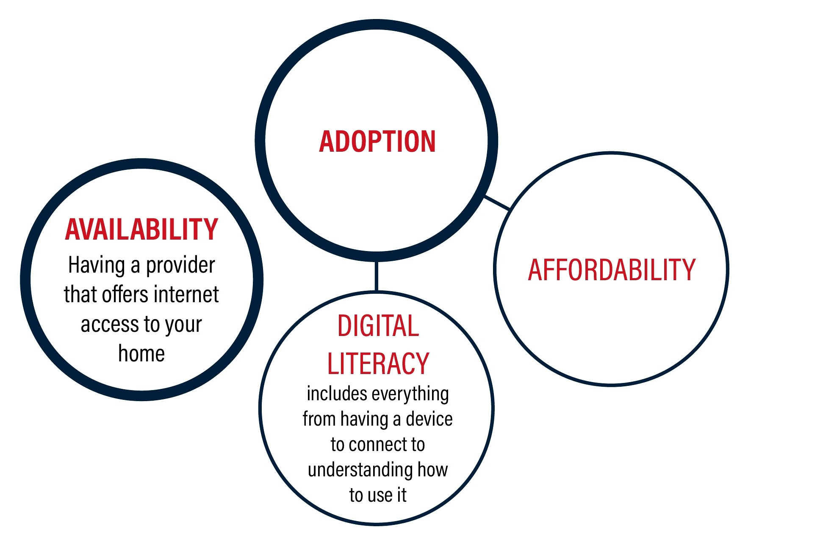

Connectivity
Defined

Slide 29

Broadband Availability Gaps 2021
Consumer-initiated, on-the-ground tests show levels of internet connectivity in Ohio households.

Slide 30
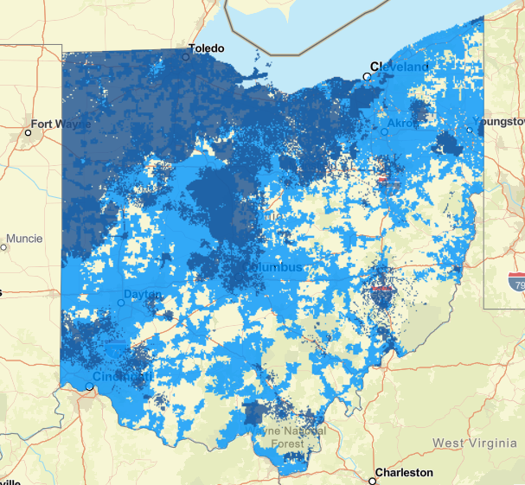
Broadband Availability Gaps
Minimum Speeds for General Applications
Broadband 25 Mbps Download / 3 Mbps Upload
Detailed Service Areas- 25 Mbps Download/ 3Mbps Upload
FCC Service Availability - 25 Mbps Download/ 3 Mbps Upload
Data Source: Connected Nation Ohio
FCC National Broadband Map

Slide 31
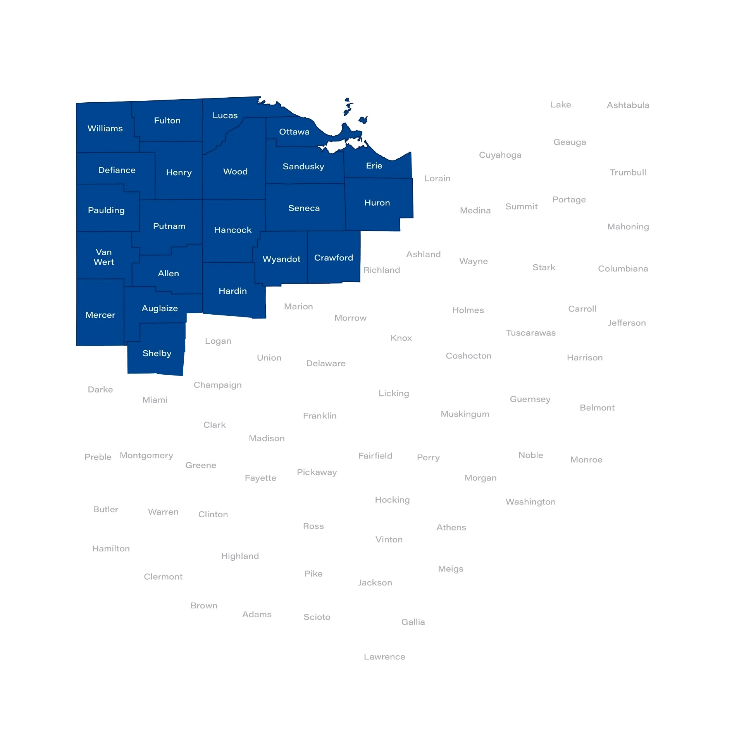
Northwest Ohio RDIA Region
Allen
Auglaize
Crawford
Defiance
Erie
Fulton
Hancock
Hardin
Henry
Huron
Lucas
Mercer
Ottawa
Paulding
Putnam
Sandusky
Seneca
Shelby
Van Wert
Williams
Wood
Wyandot

Slide 32

Regional Connectivity – Data Summary
County | (Underserved) 25/3 % | Households | (Unserved) 10/1 % | Households | HH with a Computer | HH Internet Subscription
Allen | 18 | 8,420 | 11 | 5,078 | 90.6 | 85.3
Auglaize | 40 | 7,967 | 18 | 3,542 | 91.7 | 86.4
Crawford | 26 | 5,554 | 18 | 3,875 | 90.6 | 84.3
Defiance | 34 | 6,307 | 26 | 4,706 | 91.1 | 84.5
Erie | 27 | 10,767 | 12 | 4,587 | 91.4 | 81.6
Fulton | 40 | 7,725 | 30 | 5,776 | 92.3 | 87.1
Hancock | 22 | 59 | 13 | 4,493 | 93.7 | 88
Henry | 43 | 5,740 | 33 | 4,421 | 89.8 | 82.3
Hardin | 42 | 6,042 | 28 | 4,099 | 91.7 | 87.5
Huron | 29 | 7,876 | 18 | 5,061 | 90.9 | 83.4
Lucas | 21 | 39,276 | 7 | 13,075 | 92 | 86.2
Mercer | 37 | 7,480 | 22 | 4,470 | 92.1 | 89.1
Ottawa | 25 | 7,463 | 12 | 3,443 | 92.2 | 83.1
Paulding | 62 | 6,116 | 43 | 4,246 | 88.5 | 77
Putnam | 64 | 9,645 | 43 | 6,447 | 92.3 | 85.3
Sandusky | 27 | 8,270 | 17 | 5,122 | 90.2 | 83.2
Seneca | 34 | 8,670 | 24 | 6,055 | 90.3 | 83.8
Shelby | 37 | 7,866 | 25 | 5,278 | 90.3 | 87.1
Van Wert | 41 | 5,723 | 28 | 3,888 | 90.8 | 82.9
Williams | 43 | 8,104 | 33 | 6,218 | 89.1 | 84.2
Wood | 23 | 12,711 | 12 | 6,619 | 95.2 | 89.7
Wyandot | 51 | 5,452 | 36 | 3,820 | 91.6 | 84.7

Slide 33
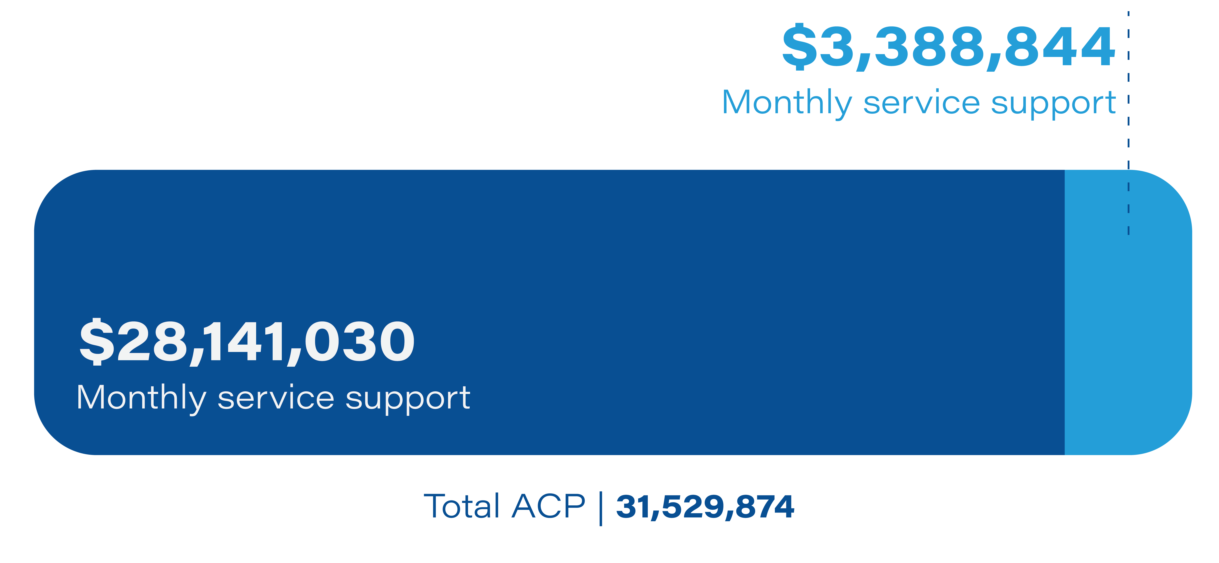
ACP Claims Tracker Data
Top 2 Counties:
Lucas | 10,518,069
Allen | 3,014,802
Bottom 2 Counties:
Putnam | 216,927
Paulding | 233,904

Slide 34
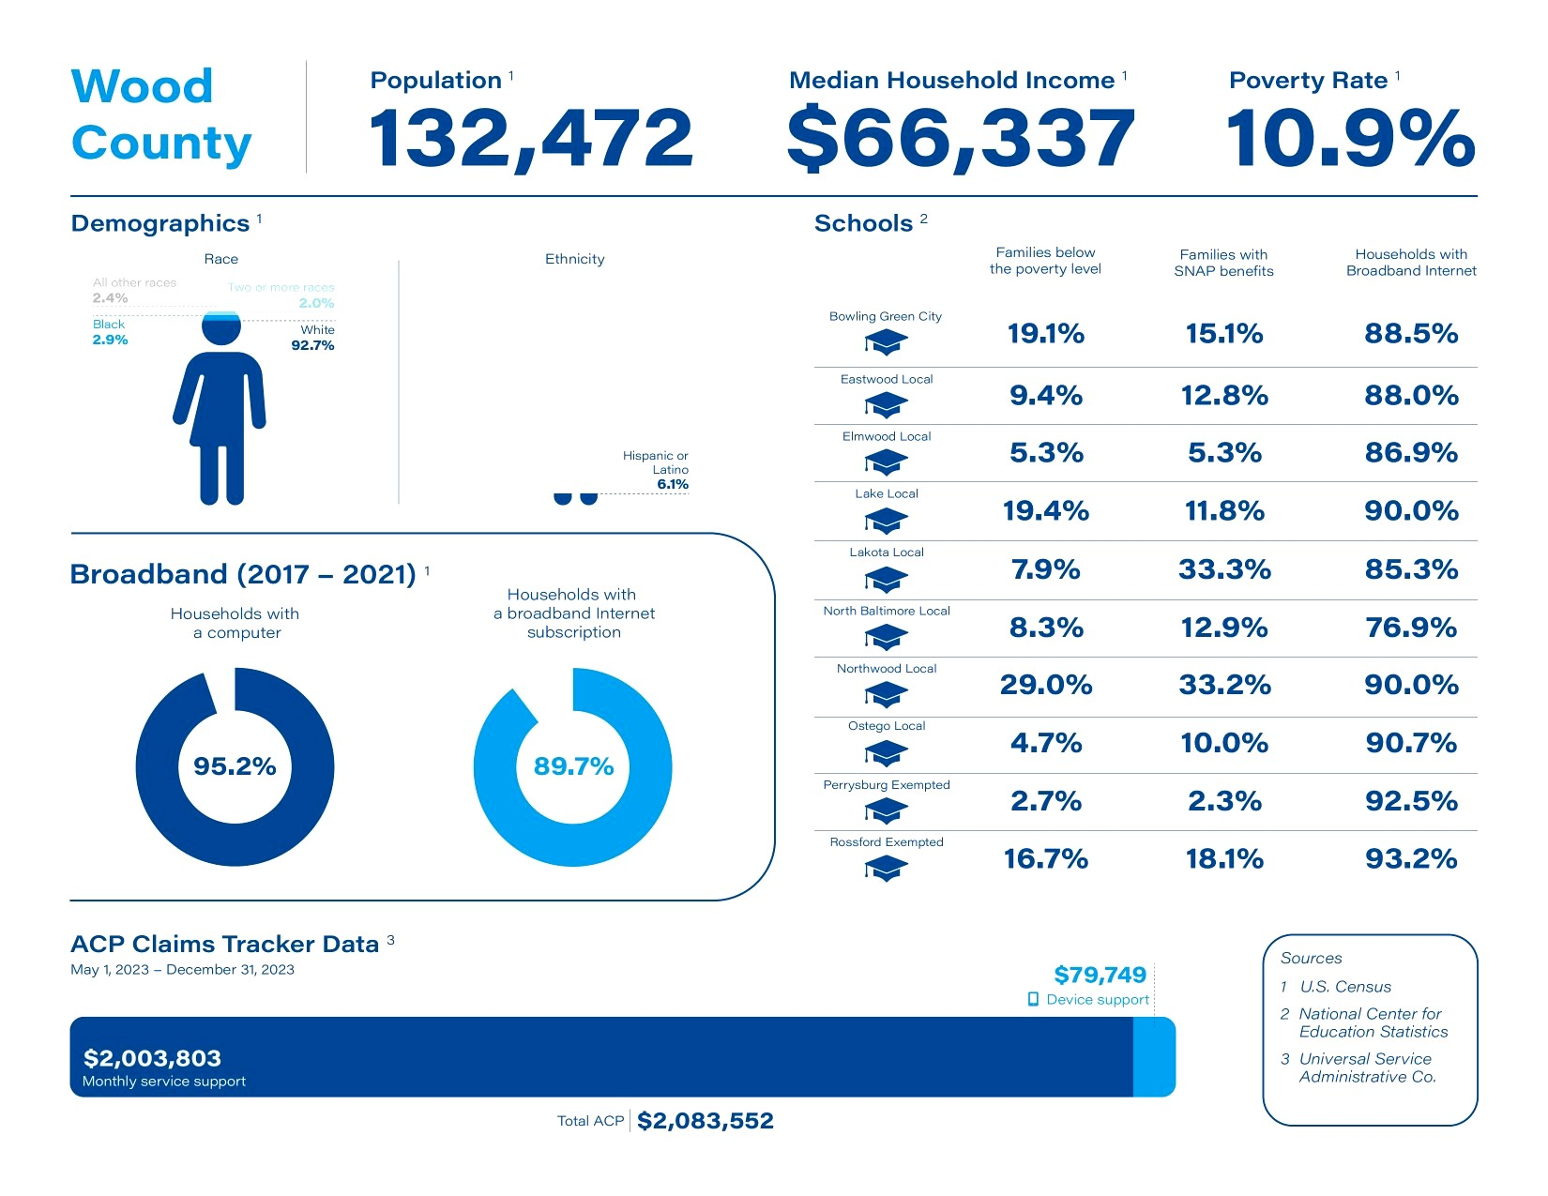
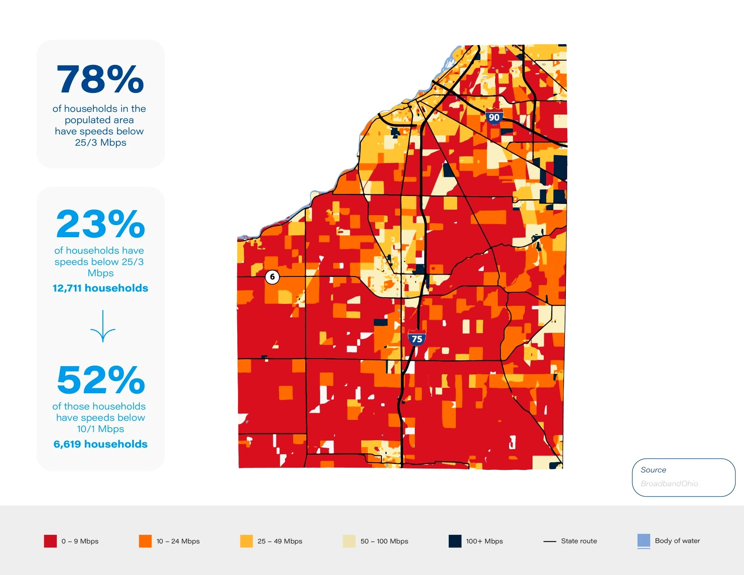
RDIA County Connectivity Profile

Slide 35
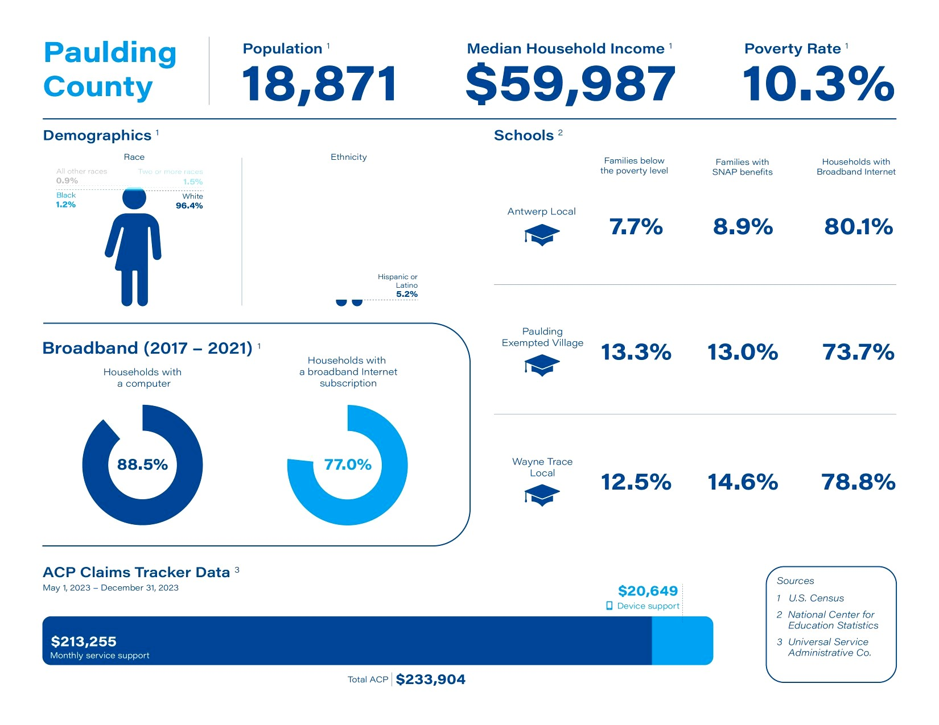
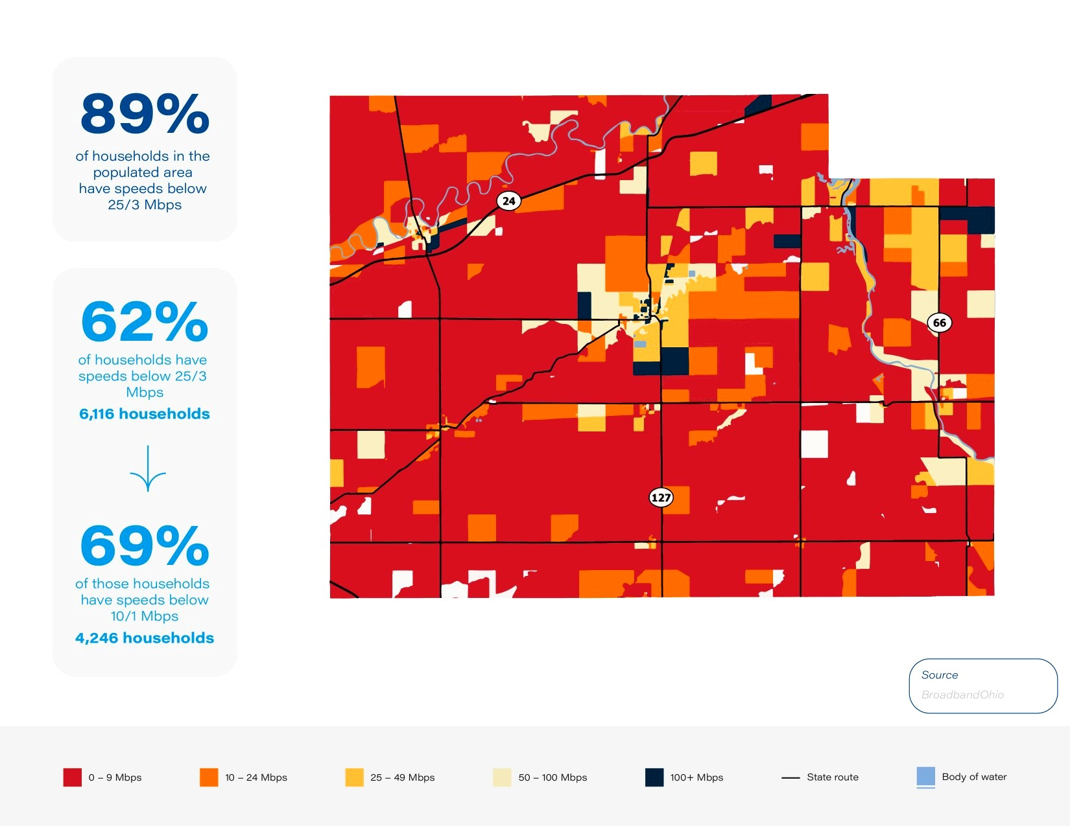
RDIA County Connectivity Profile

Slide 36
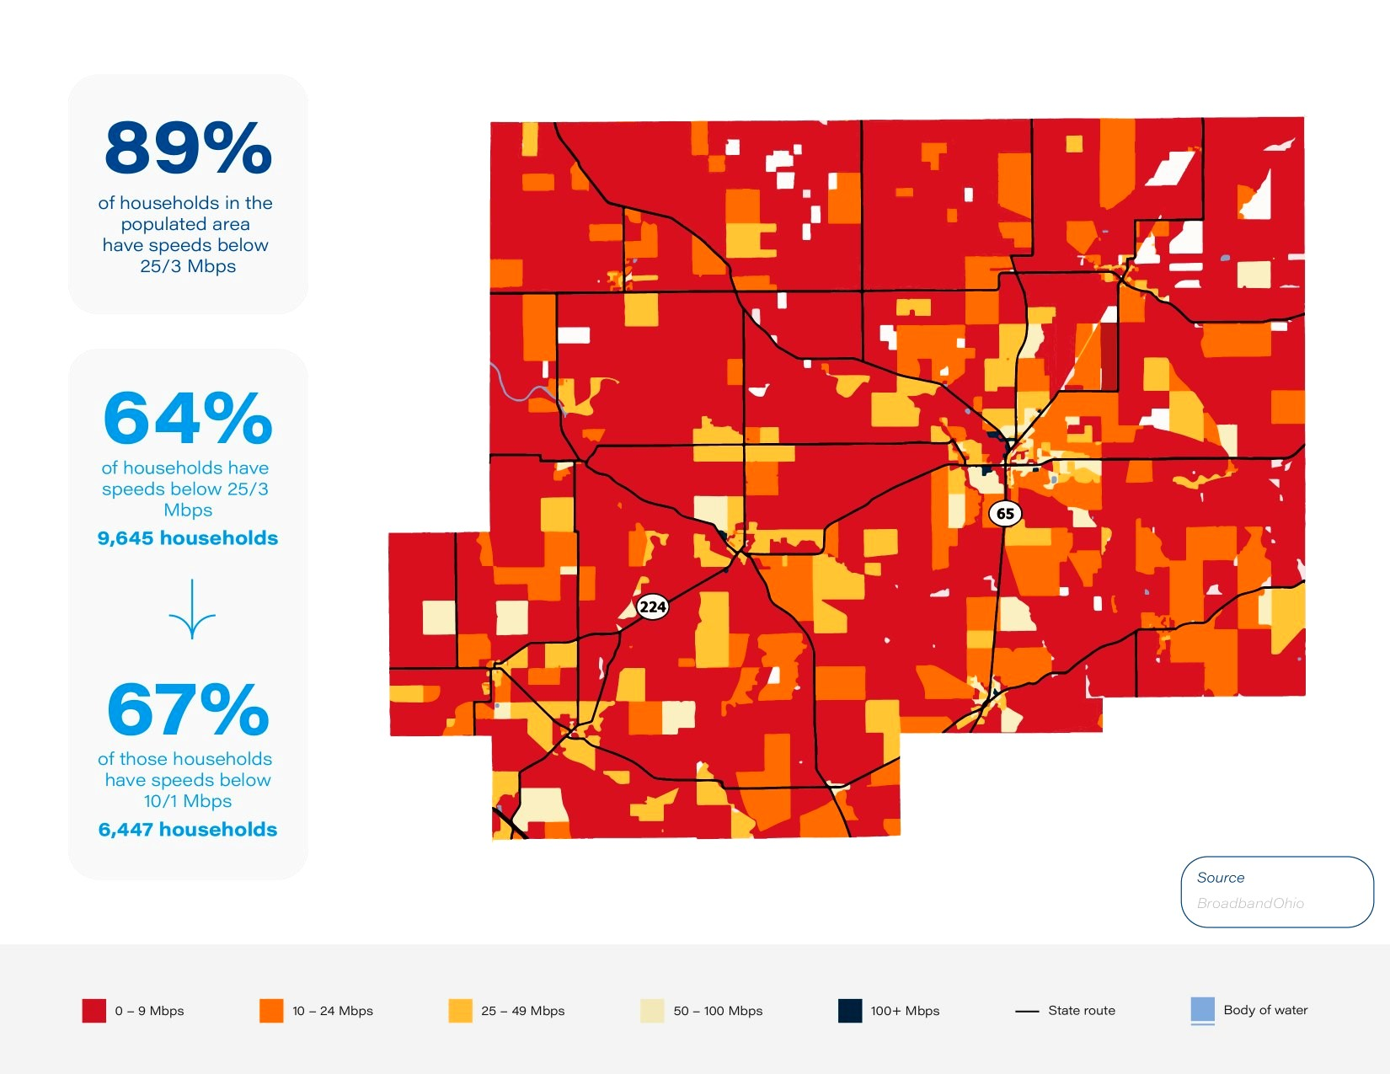
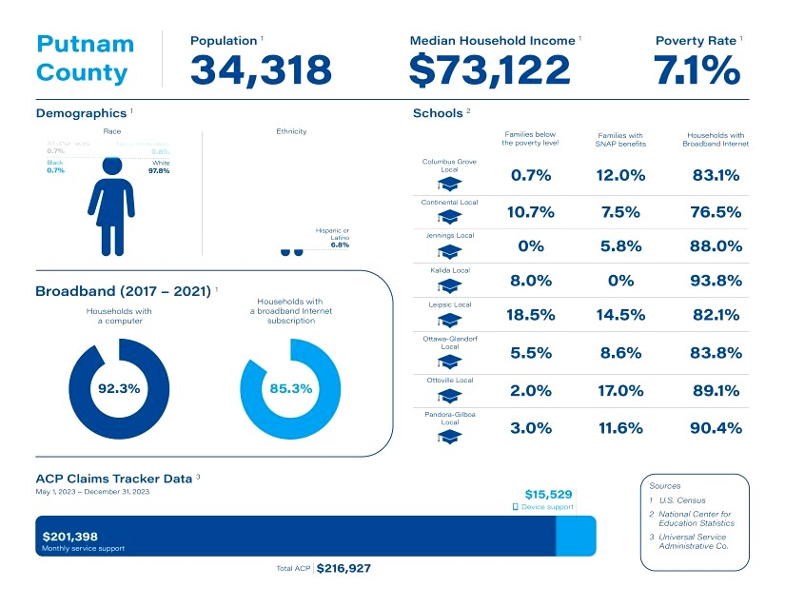
RDIA County Connectivity Profile

Slide 37

Data for Improved Connectivity
Northwest Ohio RDIA Data Collection & Ongoing Regional Efforts
Internet Use & Connectivity Needs
Device Access
Digital Literacy

