Slide 1
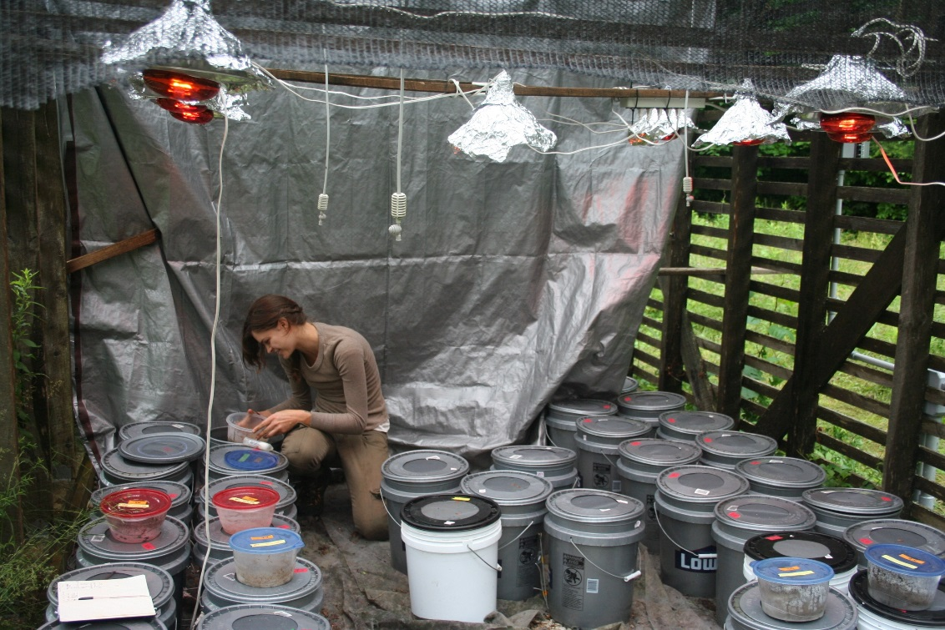
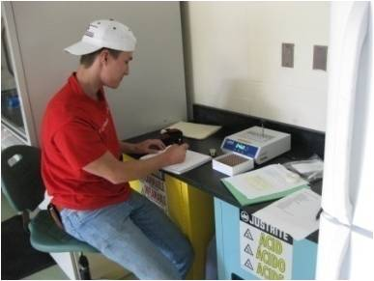
Why Should you do research while colleging?
Increases sense of community
Learn the joys & pitfalls of scientific discovery
Get synced with people who have opportunities & can write strong letters of recommendation
Get a leg up on competition for jobs, grad school, etc.!

Slide 2
Find a lab home!
Scan BGSU faculty page, reach out (more on this later) to professors whose classes you enjoy. Check bulletin board outside of 312 LSC.
Connect with Marine or Herpetology labs, Lake Erie & Watershed Studies

Slide 3
Find a lab home!
Scan BGSU faculty page, reach out (more on this later) to professors whose classes you enjoy. Check bulletin board outside of 312 LSC.
Connect with Marine or Herpetology labs, Lake Erie & Watershed Studies
life hacks
Pay attention to grad students!
Ask to attend lab meetings
Go to seminars
Offer to volunteer (as a last resort- more later)

Slide 4
Email or stop by faculty office hours.
life hack
The bio office knows faculty office hours. See Patti.
Most, but not all, hiring occurs in winter, for summer jobs.

Slide 5
Email or stop by faculty office hours.
life hack
The bio office knows faculty office hours. See Patti.
Most, but not all, hiring occurs in winter, for summer jobs.
If you’re not ready to jump in, prime by routinely chatting with professors/TAs, express gratitude, tell us about good youtube videos, connections between course material & your life, etc.

Slide 6
Hi Dr. Pelini,
My name is XXXX and I am a freshman here at BG studying marine biology and environmental science in the honors college. Last semester I was in your BIO 3540 class and I was very interested to hear about the research you and your graduate students are working on. I am interested in completing undergraduate research before I graduate as I am planning on going to graduate school in the future to further my education. If you are willing I would love to give anytime I have to help you or your graduate students in their research. If you have the time and this is a possibility for the future I would like to set up a meeting to talk to you about it. Thank you for your time and I look forward to hearing back from you.
Sincerely,
XXXX

Slide 7
Hello Dr. Pelini!
My name is XXX and I am currently studying biology as a first year and am looking to get into studying ecology as well. Your name came up in my recent advising appointment with Christine Shaal and I decided to read some of your research and I love what you are studying! I was emailing also to ask if you had any research that I can join or if there was any other way I could help you or shadow you or your research in any way so that I can experience some ecology or biology research first hand and get a head start with my experience. If you have any availabilities or would just like to meet and discuss some of your research I would be delighted!
Thank you for your time,
XXX

Slide 8
life hacks
Start early. We LOVE students who may stick around for the long haul. This increases the potential for the student to present at a conference, publish, get a national fellowship, and network.

Slide 9
CURS: Center for Ugrad Research & Scholarship
Elligibility: Requires identification of mentor, project narrative, budget. Any class
Fall/Spring Semester Grants
$500 for supplies + $200 stipend
Due mid August or early December
Winter Semester Grants
$300 for supplies + $100 stipend
Due mid November
Summer
$500 for supplies + $2,000 to $2,500 stipend
Due mid March
Travel Grants
$200 for travel to present at a conference
Limit 1/year/student
Rolling Deadline
https://www.bgsu.edu/provost/center-for-undergraduate-research-and-scholarship.html

Slide 10
https://www.bgsu.edu/trio-programs/mcnair-scholars-program/program-overview.html
Ronald E. McNair Scholars Program
Eligibility:
2 yr program. Sophomores rising to junior, or juniors rising into senior, if not graduating in one year
2.7 GPA
Be a first generation student, meaning no parent has received a four-year, bachelor's degree, who is economically disadvantaged (as determined by the US Department of Education criteria), OR be a student from a group that is historically underrepresented in graduate programs (African American, Latino/Hispanic, or Native American)
Interested in STEM PhD or ED
Benefits:
$2800 summer research stipend
Graduate school visits & application fees. Lots of mentoring, workshops, some coursework to help.
Some housing costs covered

Slide 11
Get Course Credits
If a summer job is biological in nature, you may receive up to 3 hours credit in BIOL 4890.
Biology 4010 is an independent study course that you can register for, with permission from a faculty mentor. You must have completed four semesters of biology prior to enrolling in BIOL 4010. You may repeat the course, but a maximum of 4 hours will count toward the 32 credit hours of biology courses needed in the major.
https://www.bgsu.edu/arts-and-sciences/biological-sciences/undergraduate-programs/internships.html

Slide 12
BGSU Biology Honors
Eligibility: 3.5 GPA
Typical timeline for the Biology Honors Program:
1. Talk with mentor – Sophomore or Junior year
2. Register for BIOL 4700H and BIOL 4010H – Junior year
3. Submit research proposal – Junior year
4. Work on research project – Junior and Senior years
5. Write thesis (BIOL 4020H) – last semester
6. Present project (BIOL 4020H) – last semester
https://www.bgsu.edu/content/dam/BGSU/college-of-arts-and-sciences/biological-sciences/documents/UGRD%20Handbook/Biology%20Honors%20Program.pdf/subassets/page1.pdf

Slide 13
This activity requires you to identify two BGSU Faculty from the Department of Biological Sciences (or other Science departments), with whom you could potentially complete an Undergraduate Research Experience.
http://www.bgsu.edu/arts-and-sciences/biological-sciences/faculty-and-staff.html
For each Faculty selected, describe:
1. Why would you be interested in joining the faculty lab?
2. What goal might you be able to achieve in this particular group?

